Slide 1
Group Project
Level 4/5 Group 19
Ogheneochuko Ideh
Thomas Barrett
Samuel Ormondroyd
Notes:
Welcome to the pitch presentation of group 19.
I am : state names

Slide 2
Game Title TBC
Presented to:
Stakeholders & Ubisoft Bucharest
01/02/2017

Slide 3
Market overview
Projected demographics | Unisex audience. Primarily targeted from ages 7 – 14 Apriopiate for children (and adults) ages seven and up.
Genre: | The triple A Action, Arcade, Adversary
Platform Specs: | Windows Unity Excecutable
Notes:
Before we begin, here is a brief run through of our market overview/game specs.
Projected demographic: We are targeting our game off the success of the games such as angry birds. The game will be geared towards children of both genders from 7 and up, although the game is also open to a universal audience.
This is because the game will induct simple to learn mechanics that will still pose a challenge to master.
The genre of our game is something we dubbed; Tripple A.
This is Action, Arcade, and Adversary.
The premise and overall goal is to beat your opponents score.
Platform Specs:
The game will be playable on PCs as a Windows executable file

Slide 4
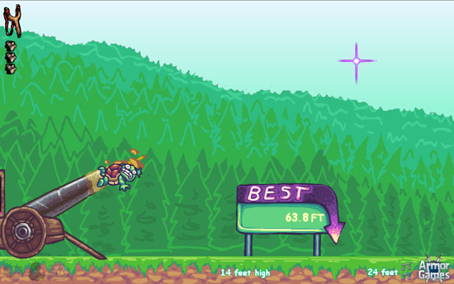
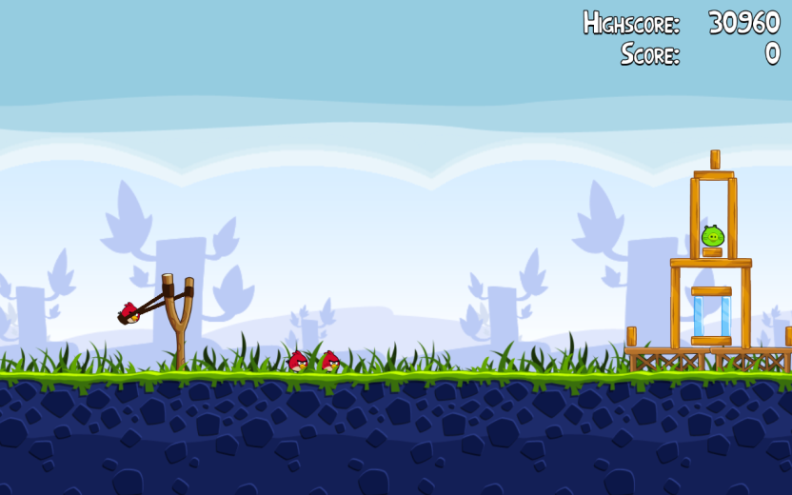
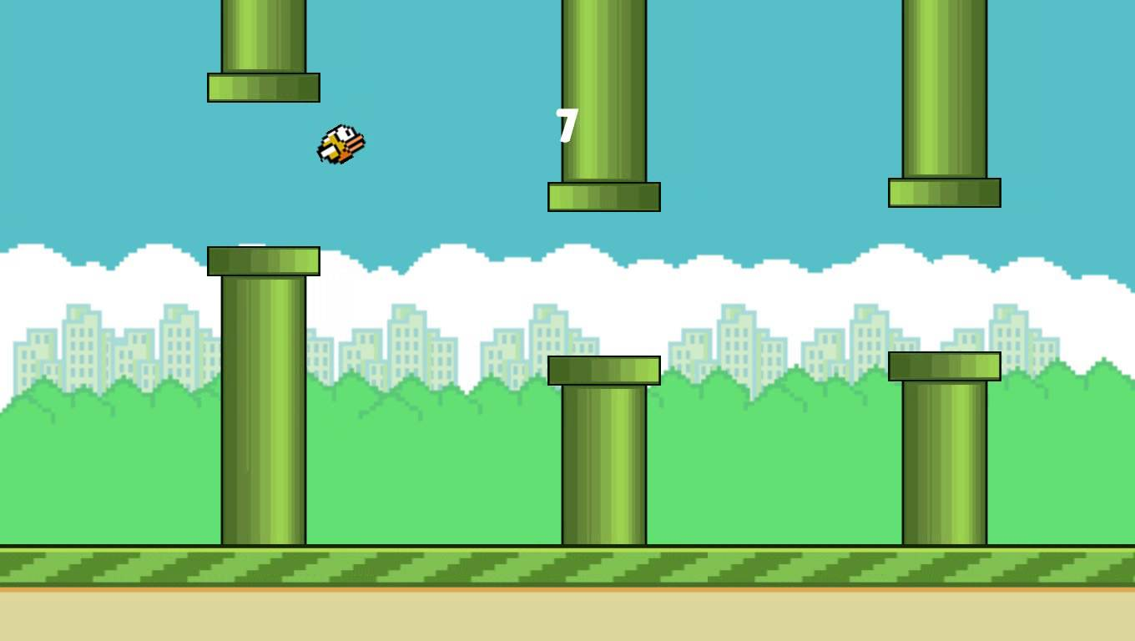
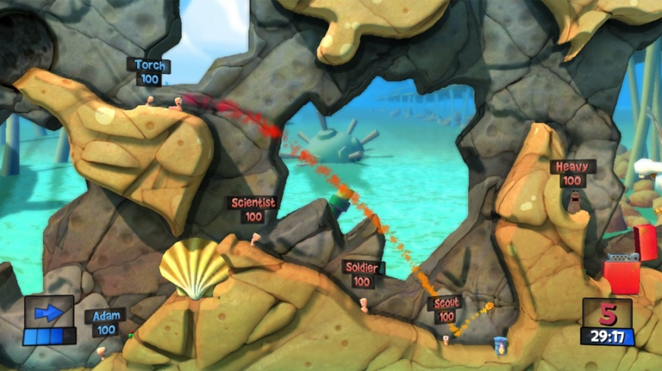
Inspirations
Toss the turtle
Angry Birds
Flappy Bird
Worms
Notes:
During our research, we were fond of games which featured trajectory and momentum as central mechanics.
These mechanaics take center stage in games such as ......... Etc.
We aimed to incooporate these mechamnic as they would allow players to take stragigly thought out playthroughs, as they will be calculating where the projectile will land and how far it could travel.

Slide 5
Logline
TBC
Notes:
The logline for our game goes as follows:

Slide 6
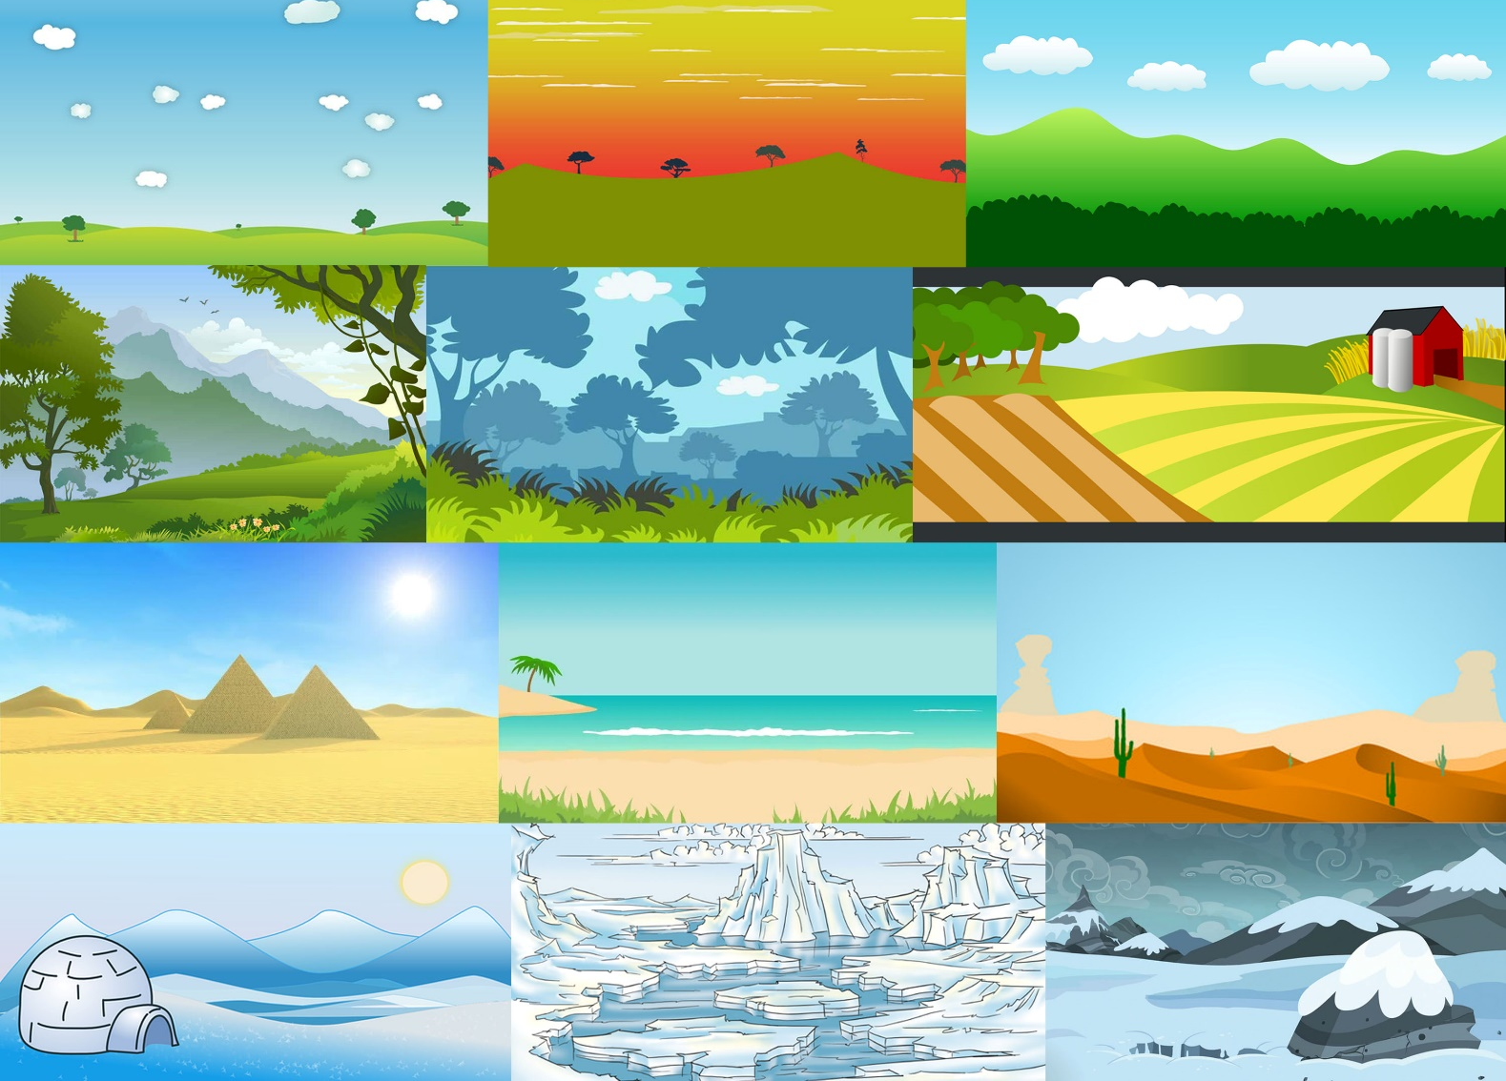
Moodboards and concept
Notes:
The mood board display multiple suggestive background themes for the games level. These themes are based around birds and their habitats.
Foregrounds will be developed to run along side the background. The foreground being the main playing field of the game will house uneven geometry posing as a challenge for players.

Slide 7
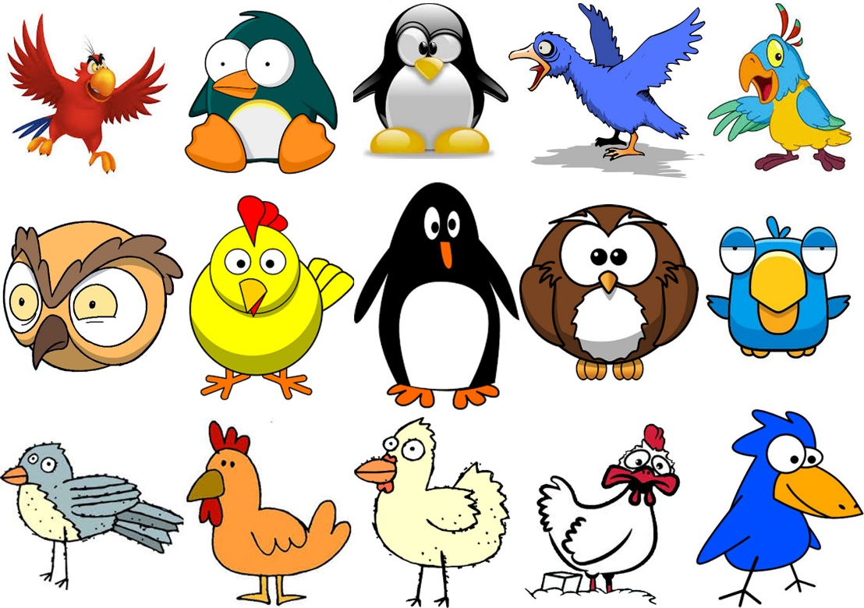
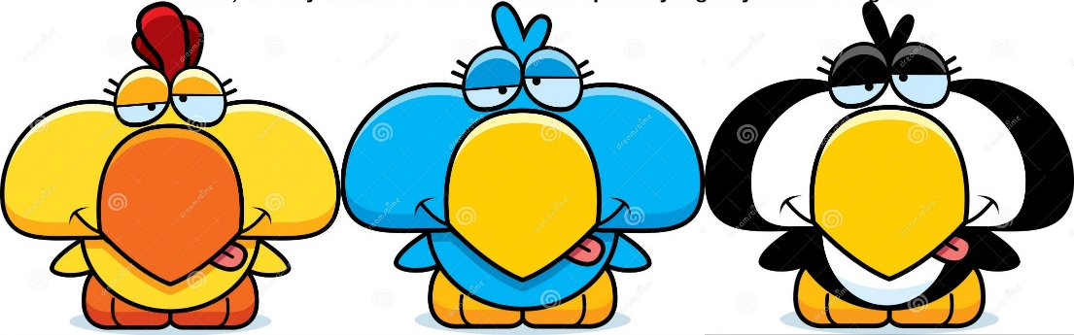
Moodboards and concept
Notes:
Using cartoon like and quirky art will add to the overall comedic tone of our game.

Slide 8
Game play and apperence
Prototype Showcase
Action, physics, adversary, turn based game.
Main gameplay will take place on landscape 2D overworld.
Using the catapult, players can adjust the trajectory and momentum of the flightless birds in order to travel the furthest distance.

Slide 9
Game play and apperence
Prototype Showcase
Players can use the stamina to either thrust bird upwards or forwards.
Thrusting forwards allows the bird to travel higher, thereby increasing the momentum of eventual impact.
Players can trust be repeatedly pressing the allocated keys, which in turn causes a twitch mechanic.
The larger the momentum upon impact, the further the bird will recoil.

Slide 10
Game play and apperence
Prototype Showcase
Thrusting forward will allow the bird to travel further prior to impact.
Players stamina is restricted to a stamina bar seen in the UI.
The more a player thrusts the less stamina they will have in turn.
Budgeting stamina will in turn cause players to be strategic when planning to use their thrust function. Allowing for an overall strategic play.

Slide 11
Game play and apperence
Prototype Showcase
Players may also use the thrust function to avoid geometry based obstacles that may affect the distance traveled.
Once the player's bird comes to a halt the distance traveled is calculated and stored leading into the next players turn.
The player who travels the furthest wins the round.
The game consists of three rounds, best two out three wins the game.

Slide 12
Prototype Showcase

Slide 13
Player roles and actions
The main objective: Travel furthest whilst budgeting stamina.
Secondary objective: Avoid obstacles which may draw traveled distance to a halt.
Players thrust using a twitch mechanic.
Working with trajectory, momentum and budgeting stamina allows for a strategic play.

Slide 14
Development specifications
Unity 2D
MonoDevelop / Visual studios
Photoshop

Slide 15
Achieving Fun
Hard Fun
People fun
Serious fun
Notes:
Hard fun: Goals Obstacles and Strategy
People fun: Compete, this creates an amusement emotion
Serious fun:
Repetition, rhythm this creates excitement

Slide 16
Scope and End Goals
We are here
End goals
Strech goals
End goals
Functional two player build.
Preceduarly generated plain.
Sound effects
Strech goals
Animation.
Parallax scrolling background.

Slide 17
Questions?

